Slide 1

File and Printer sharing in Windows NT Environment
NATIONAL INSTITUTE OF ELECTRONICS AND INFORMATION TECHNOLOGY
Birla Farms, Bada Phull, Ropar
NIELIT ‘O’-Level
IT Tools and Network basics

Slide 2
Word Processing

Slide 3
Index
Introduction to Word Processor
Understanding GUI – Title bar, Menu Bar, Toolbars & sidebar
Creating a new document
Opening and closing documents
Saving a document
Printing a document – Print Preview, creating PDF
Text creating and manipulation
Cut, Copy and Paste Text
Find and Replace Text
Formatting
Character Formatting – Font, color, style and size
Paragraph formatting – Alignment, indentation, spacing, Bullets & numbering
Page Formatting - Margins, Page setup and layout, Watermark, Background and Border
Header and footer

Slide 4
Index
Changing case
Spelling and Grammar Checking
Automatic spell checking
Spell checking an entire document
Grammar Checking
Selecting the document language
Word completion
Hyperlinks
Creating Hyperlink
Edit and Delete Hyperlink
Hyperlinks to Images
Footnotes and Endnotes
Inserting Footnotes and Endnotes
Delete Footnotes and Endnotes

Slide 5
Introduction to Word Processor

Slide 6
Introduction
A word processor is a computer program that provides for input, editing, formatting, and output of text and some additional features to make your document effective.
LibreOffice Writer is the word processor component of LibreOffice, a freely available, fully-featured office productivity suite.
In addition to the usual features of a word processor (text entry, editing, and formatting; spelling checker, thesaurus, hyphenation, and autocorrect; find and replace; and others), it provides some important other features such as Change tracking during revisions, Export to PDF, Automated tables of contents and indexes, Templates and styles and many more.

Slide 7
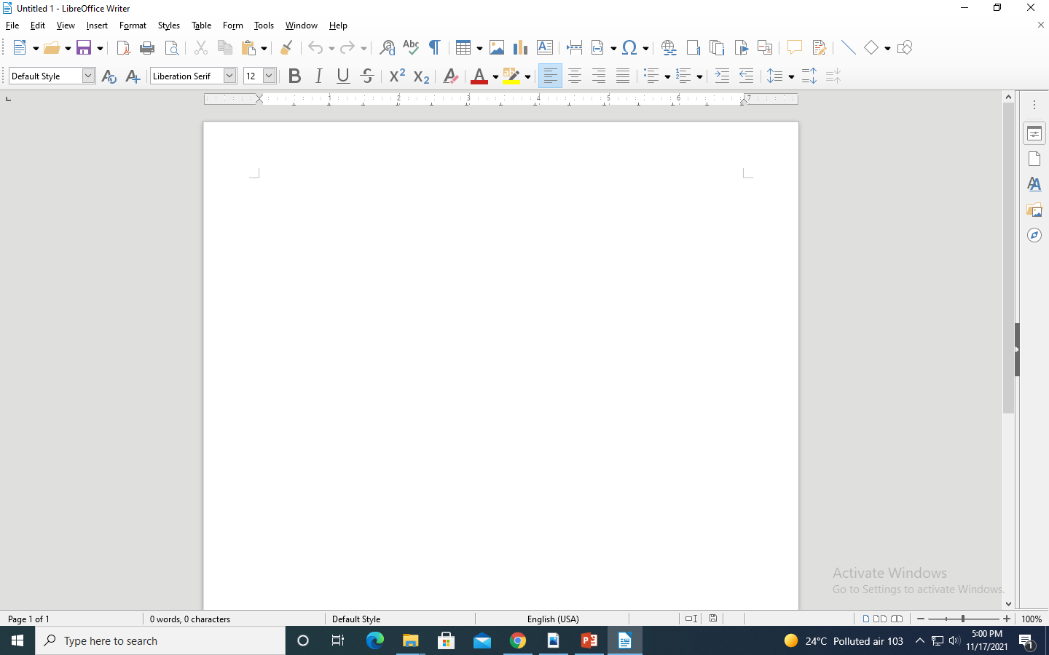
Understanding GUI

Slide 8
Understanding GUI
Title Bar
The Title bar is located at the top of the Writer window. It shows the file name of the current document. When the document is not yet named, the document name will appear as Untitled X, where X is a number. Untitled documents are numbered in the order in which they are created.
Menu Bar
The Menu bar is located just below the Title bar in Windows and Linux and at the top of the screen in macOS. When you select one of the menus, a submenu drops down to show further options.

Slide 9
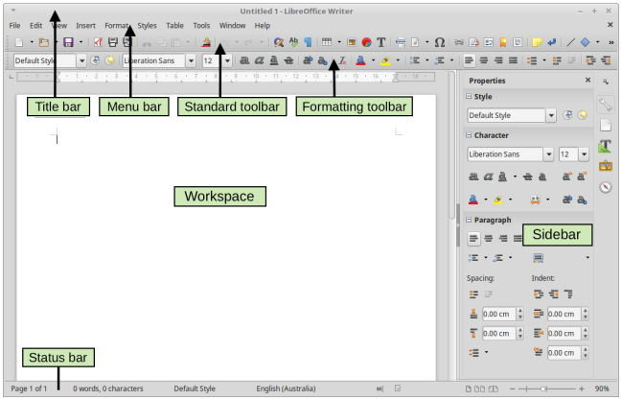
Understanding GUI

Slide 10
Understanding GUI
Sidebar
The Sidebar is normally open by default on the right side of the Writer window. If necessary, select View > Sidebar from the Menu bar to display it. The Writer Sidebar contains five decks by default:
Properties
Page
Styles
Gallery
Navigator.
Each deck can be opened by clicking its corresponding icon on the Tab bar to the right of the sidebar.

Slide 11
Understanding GUI
Toolbars
LibreOffice has two types of toolbar locations: docked (fixed in place) or floating. Docked toolbars can be moved to different locations (for example, top, bottom, or side of the workspace) or made to float. Floating toolbars can be docked.
Displaying or hiding toolbars
To display or hide toolbars, go to View > Toolbars on the Menu bar, then click the name of a toolbar in the drop-down list. An active toolbar shows a checkmark beside its name.
To hide a toolbar, go to View > Toolbars on the Menu bar and deselect the toolbar

Slide 12
Understanding GUI
Rulers
The horizontal ruler is visible by default but the vertical ruler on the
left is hidden by default. To enable the vertical ruler, choose View > Rulers > Vertical Ruler from the Menu bar.
Status bar
It is located at the bottom of the workspace. It provides information about the document

Slide 13
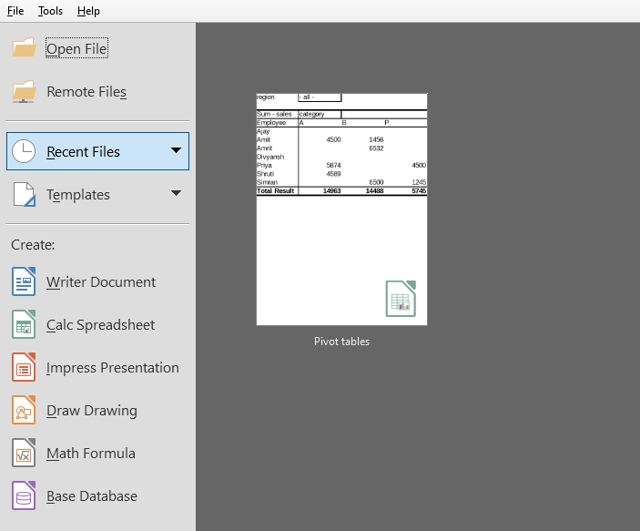
Creating a new document
Choose Create -> Writer Document from left pane to create a new document
You can also choose to work with a starting template.

Slide 14
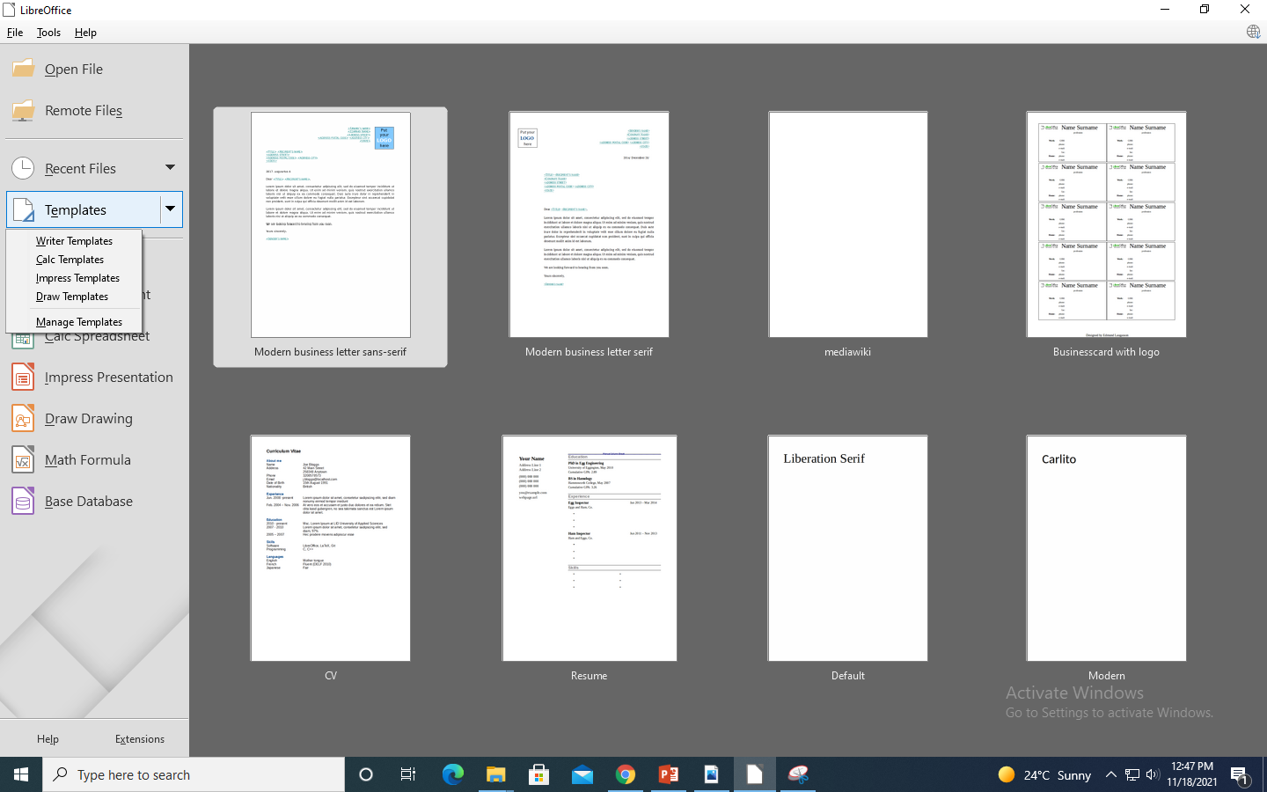
Creating a new document

Slide 15
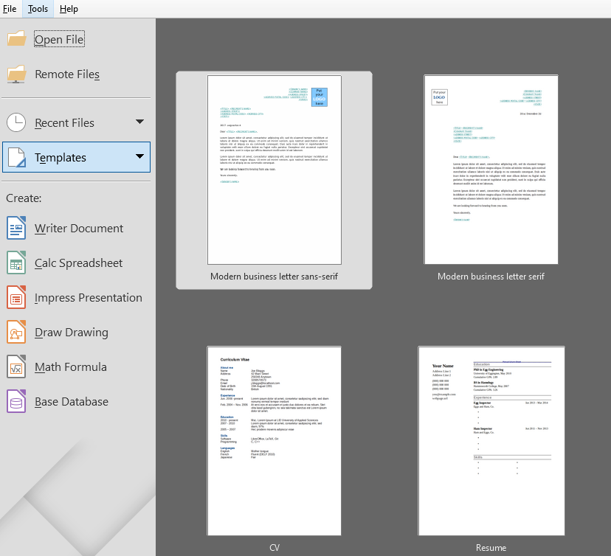
Opening an existing document
Click Open file option from the left pane to open an already existing document
Also you can use the keyboard shortcut Ctrl+O to open a document.

Slide 16
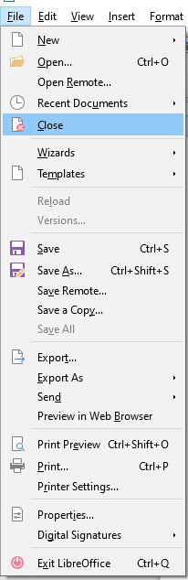
Closing a document
Choose File->Close from the menu to close the currently open document
or click the X on the Title bar.
To close LibreOffice completely, go to File > Exit LibreOffice
on the menu bar or

Slide 17
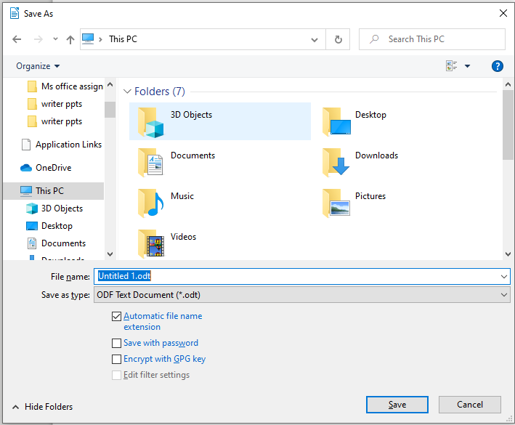
Saving a document
Choose File -> Save from the menu bar
Also you can use keyboard shortcut Ctrl+S to save a document
Or Click the Save icon on the Standard toolbar.
Choose File->Save as ,if you want to
save the current version as a new document
by changing the file name or file type, or by
saving the file in a different location on your
computer.

Slide 18
Printing a document
LibreOffice Writer provides all the tools to print a document with various options and to preview a document before we send it to the printer.
Preview printing
It's always a good practice to preview a document before actually printing it. With preview we can spot errors and thus avoid wasting time and paper. To open the preview window press the icon from the Standard toolbar.
When we enter the preview window the Preview toolbar appears. Using this toolbar we can control the viewing and navigate through the document.

Slide 19




Printing a document
Icons | Commands
 | Control the view layout. The options are Single Page View Two page View Book View Multiple Page View
 | Navigate through the document. The options are to go to First page Previous page Jump to a specific page Next page Last page
 | Control the zooming. The options are Zoom Out Set specific zoom level Zoom In
 | Print the Document Full Screen Mode
 | Close (Exit) Preview window
After examining the document, one can press the print icon or the close window icon to exit the preview window

Slide 20
Printing a document
Quick Printing
If the Print Directly icon is visible on the Standard toolbar, you can click it to send the entire document with the current default print settings.
Printing using print dialog
For more control over printing, use the Print dialog windows which has several tabs. From this window we can set various printing options.

Slide 21
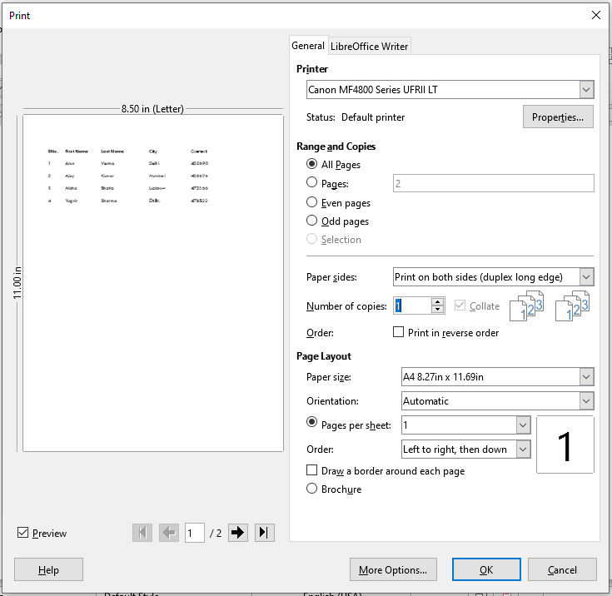
Printing a document

Slide 22
Printing a document
General tab options:
Printer
Choose the printer when there are multiple printers installed in our system
Range and Copies
The default is to print all pages, but we can specify to print specific pages (1, 3, 7) or a part of a document (i.e pages 2-10).
We can also specify to print multiple copies.
Paper sides
You can choose to print on just one side of paper or both sides
Layout
We can set to print multiple pages per sheet of paper.
We can choose from two Orientation : Portrait or Landscape
Brochure : You can print a document with two pages on each side of a sheet of paper, arranged so that when the printed pages are folded in half, the pages are in the correct order to form a booklet or brochure

Slide 23
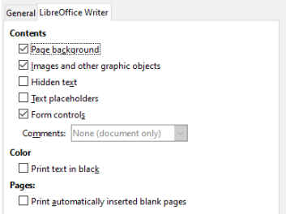
Printing a document
LibreOffice Writer tab :
On the LibreOffice Writer tab, you can choose to print a subset of contents (for example, images or hidden text), print text in black (even if a color is defined for the text), to print automatically inserted blank pages, and where to print any comments that are in the document.

Slide 24

Quick export to PDF
Click the Export Directly as PDF icon in the Standard toolbar,
or File > Export As > Export Directly as PDF, to export the entire document using the PDF settings you most recently selected in the PDF options dialog.
Export as pdf

Slide 25
Text creation and manipulation

Slide 26

Cut, Copy and Paste text
One can copy or move text within a document or between documents, by dragging or by using menu selections, icons, or keyboard shortcuts. Text can also be copied from other sources such as Web pages and paste it into the document.
To move (drag and drop) selected text using the mouse, drag it to the new location and release it. The shape of cursor changes while dragging.
To copy selected text, hold down the Ctrl key while dragging. The text retains the formatting it had before dragging.
To move (cut and paste) selected text, use Ctrl+X to cut the text, insert the cursor at the paste-in point and use Ctrl+V to paste. Alternatively, use the buttons on the Standard toolbar.
To copy (copy and paste) selected text, use Ctrl+C to copy the text, insert the cursor at the paste-in point and use Ctrl+V to paste. Alternatively, use the buttons on the Standard toolbar.
Cut
Copy
Paste

Slide 27
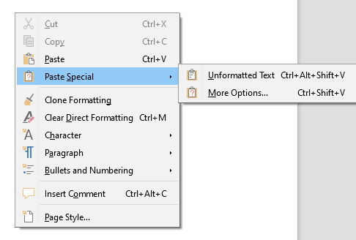
Cut, Copy and Paste text
To make the pasted text inherit the paragraph style at the insertion point:
Choose Edit > Paste Special, or
Click the arrow on the combination Paste button, or
Right click and choose Paste Special from the context menu

Slide 28
Find and Replace Text
LibreOffice Writer has two ways to find text within a document:
Find toolbar
Find & Replace dialog
Using the Find toolbar:
If the Find toolbar is not visible, it can be displayed by choosing View > Toolbars > Find on the Menu bar or by pressing Ctrl+F.
Click in the text input box and type your search text, then press Enter to find the next occurrence of that term from the current cursor position.
Click the Find Next or Find Previous buttons as needed.
Click the Find All button to select all instances of the search term within the document.
Select Match Case to find only the instances that exactly match the use of upper and lower case letters in the search term.
Click the Navigate by button to open the Navigator and the Navigation toolbar

Slide 29
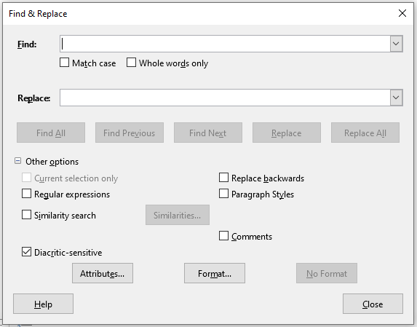
Find and Replace Text
Using Find and Replace dialog:
To display the Find & Replace dialog, use any of the following methods:
Use the keyboard shortcut Ctrl+H
Choose Edit > Find & Replace from the Menu bar
Click the Find & Replace button on the Find toolbar. When the dialog is open, optionally click Other Options to expand it.

Slide 30
Find and Replace Text
To use the Find & Replace dialog:
Type the text to be searched in the Find box.
To replace the text with different text, type the new text in the Replace box.
Various searching options can be selected, such as matching the case or matching whole words only.
The other options include searching only in selected text, searching from the current cursor position backwards toward the beginning of the document, searching for similar words, and searching in comments.
After setting up search text, click Find Next. As the document view moves to each found instance, replace the text by clicking Replace.
Clicking Find All, selects all instances of the search text in the document. Similarly, clicking Replace All, replaces all matches, without stopping for user to accept each instance.

Slide 31
Text Formatting
Formatting text helps you control how text is displayed. We can make the document more effective and attractive and emphasize important information using various formatting features such as font color, size, styles.
There are three types of formatting in a word processor:
Character formatting
Paragraph formatting
Page formatting

Slide 32
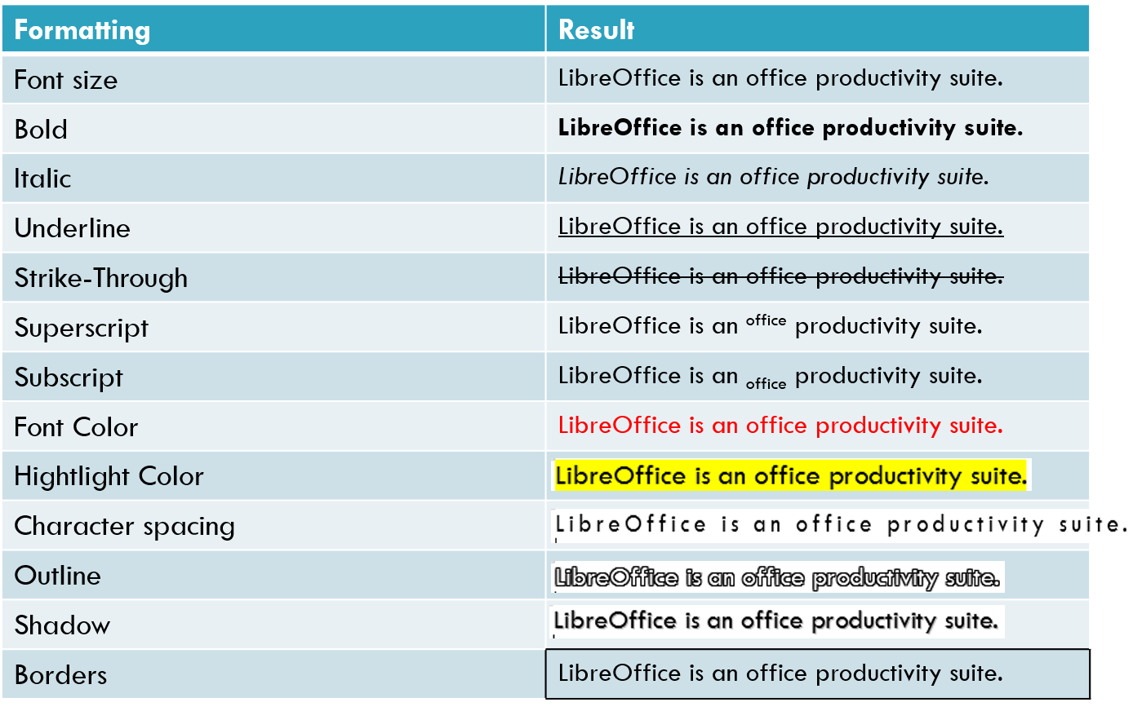
Character formatting
Character formatting refers to the formatting that you can apply on characters such as letters, numbers, and punctuation marks such as making characters bold, italics. The following table lists all the formatting commands:

Slide 33
Apply character formatting
The text should be selected in order to apply formatting. Character formating can be applied using various methods:
Formatting Toolbar
Sidebar
Character Formatting dialog window

Slide 34
Apply character formatting
Using Formatting Toolbar
Font, font size, font color
This is one of the easiest way to apply formatting such as font style, size, font color, highlighting text.
Similarly, you can apply bold, italics, underline, strikethrough, or shadow effects to selected characters
First select your text and
Click one of the available formatting buttons.
Multiple effects can be applied on the same text such as bold, underline, font color.

Slide 35
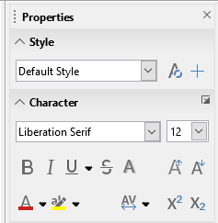
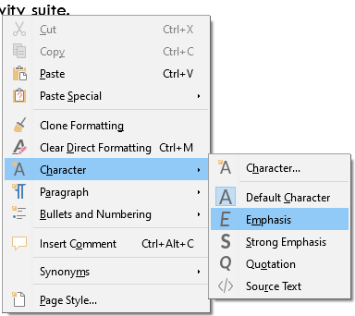
Apply character formatting
Using Character Formatting dialog window
We can use the sidebar to apply few formatting features or we can open Character formatting window using this icon
Or we can right click and use context menu to display character formatting window

Slide 36
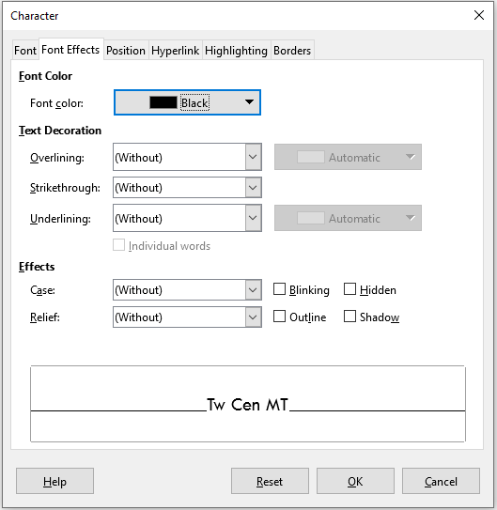
Apply character formatting

Slide 37

Clear direct formatting
To remove manual formatting, select the text and choose Format > Clear Direct Formatting from the Menu bar.
Or click the Clear Direct Formatting icon on the Formatting toolbar, or use Ctrl+M from the keyboard.

Slide 38

Clone Formatting
If you just want to copy the formatting applied on text and not the actual text, then you can use this Clone Formatting feature. Using it, one can easily clone and copy a set of formatting commands that has already been applied on some other text.
You can easily access it through standard toolbar.

Slide 39
Paragraph formatting
A paragraph in Writer refers to the text that ends with a hard return (Enter key). You insert a new paragraph in your document every time you press the Enter key.
Paragraph formatting refers to formatting that is paragraph-specific and affects the entire paragraph. Common paragraph formatting that you can apply includes alignment, indents and spacing. You can also create bulleted or numbered lists, and add borders or shading.

Slide 40
Applying paragraph formatting
Paragraph must be selected to apply formatting. Either use mouse or keyboard keys to make selection
Paragraph formatting can be applied by following ways:
Formatting toolbar
Sidebar
Paragraph Formatting dialog window.

Slide 41
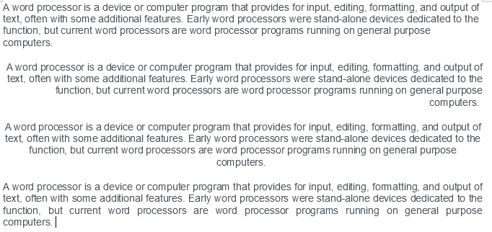
Paragraph alignment
A paragraph can be aligned horizontally left, center, right or justified left and right.
The following image shows the four types of paragraph alignment.
Left
Right
Center
Justify

Slide 42
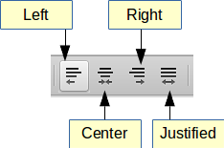
Paragraph alignment
Use the following buttons on Formatting Toolbar to align a paragraph.

Slide 43
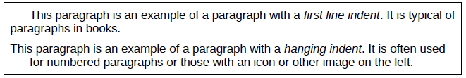
Paragraph Indents and spacing
Paragraph indent : The amount of space between the left and right page margins and the paragraph is called indent.
Paragraph spacing: It refers to the vertical spacing between one paragraph and the paragraphs above and below it.
Line spacing is the space between lines of a paragraph.

Slide 44
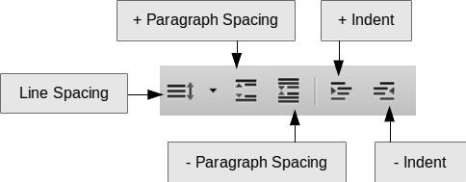
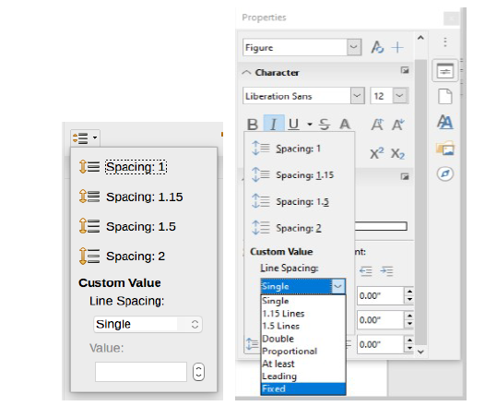
Set indents and spacing
You can quickly indent a paragraph or change spacing with the buttons in Formatting Toolbar.
Line spacing submenu is shown in image below. You can choose among standard spacing or define a custom value.

Slide 45
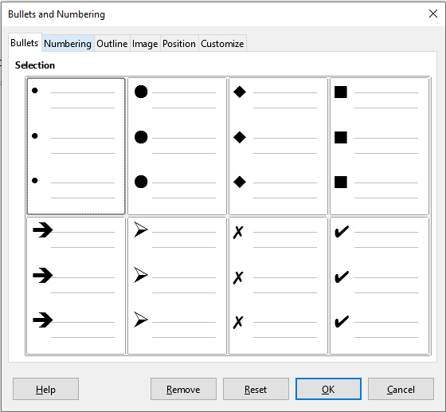
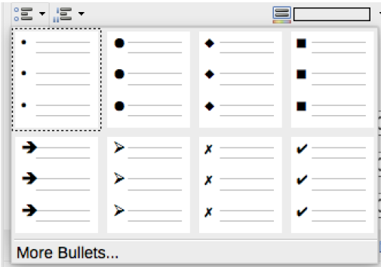
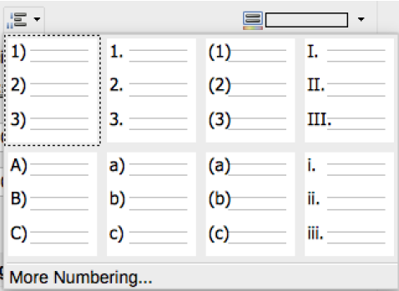
Bullets and Numbering
Bullets and Numbering lets you create an ordered list in the document.
Numbered or bulleted lists can be formatted in several ways:
Use the Bullets and Numbering toolbar
Use the Numbering and Bullets buttons on the Formatting toolbar
Use the Paragraph panel of the Properties deck of the Sidebar
Use the Bullets and Numbering dialog

Slide 46
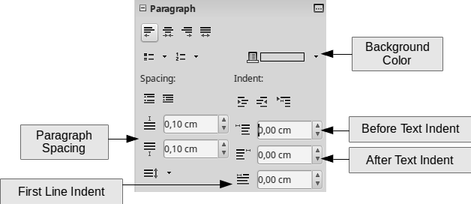
Using the Sidebar
You can use the Paragraph section on sidebar to set the paragraph properties. The sidebar includes few more options such as Background Color and first line indent.

Slide 47
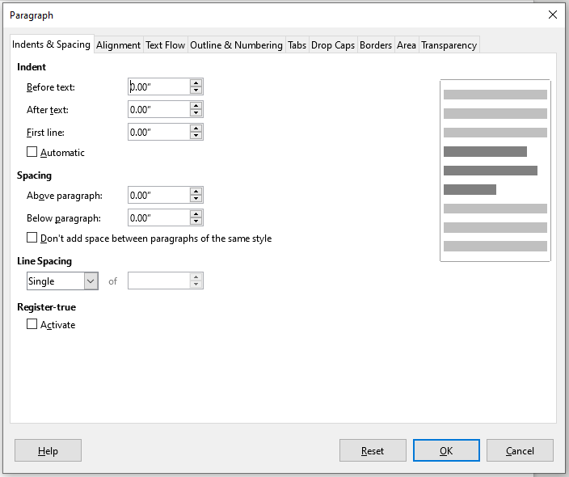
The Paragraph formatting window
Use sidebar to open paragraph formatting window
Or we can right click and use context menu to display it.

Slide 48
Page Formatting
Page formatting refers to the structure of a page and the way it is visually organized.
Writer provides several ways for you to control page layouts such as page size, margins and orientation and page elements such as headers, footers, borders and background.

Slide 49
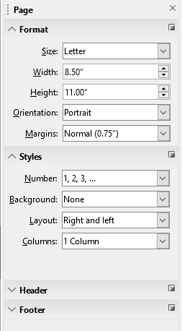
Page Setup and Layout
Page properties
To quickly edit basic page properties such as paper size, margins and orientation use the Sidebar's Page section in properties tab.

Slide 50
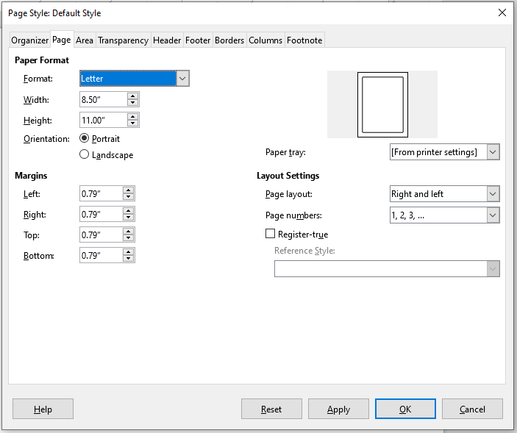
Page Setup and Layout
For more options, choose Format -> Page Style to open the Page formating window.

Slide 51
Page Setup and Layout
Page Size
Page size can be adjusted using the Page properties section of sidebar. The default paper size is Letter in Writer.
You can choose from the list of pre-defined sizes available
The most common paper size used around the world is A4, which is 210mm x 297mm.

Slide 52


Page Setup and Layout
Orientation
Writer offers two page orientation options: landscape and portrait. Landscape means the page is oriented horizontally, while portrait means the page is oriented vertically. Orientation can be changed using sidebar.
Landscape
Portrait

Slide 53
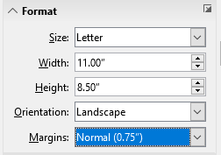
Page Margins
Page Margins
Page margins are the white space around the top, bottom, left, and right of your document. The use of white space around the page improves the appearance of document.
Page margin can be adjusted using one of the following ways:
Ruler bar
Sidebar
Page Style window

Slide 54
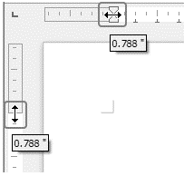
Page Setup and Layout
The shaded sections of the rulers are the margins. Put the mouse cursor over the line between the gray and white sections. The pointer turns into a double-headed arrow.

Slide 55
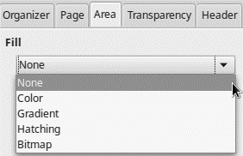
Page Setup and Layout
Page Background and Borders
Background : Adding a background color or graphic to a paragraph is a good way to make it stand out. You can customize the background using the Area tab of the Page Style dialog. With the bitmap option you can set a graphic as a page background.
Border : Borders are often used to set off paragraphs from the text without using a frame, or to separate header and footer areas from the main text area.

Slide 56
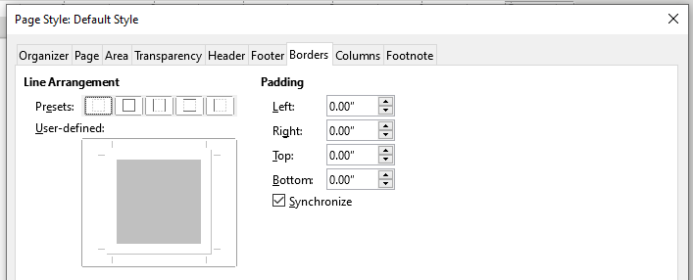
Page Setup and Layout
In above window you can set the border settings
line arrangement
line style, width and color,
shadow
spacing to contents

Slide 57
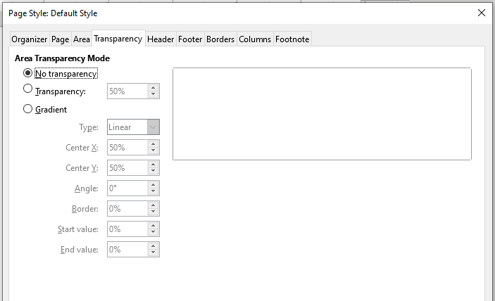
Page Setup and Layout
Background and Transparency
If the background makes the text difficult to read you can set a transparency to the background. Click on the Transparency tab and increase the setting to a desired value

Slide 58
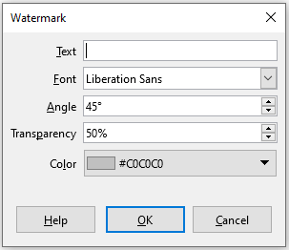
Watermark
Watermark
Watermark is a logo or text in the background of a page typically showing the company name or a statement such as Draft.
To insert a watermark into you document, go to Format ->watermark

Slide 59
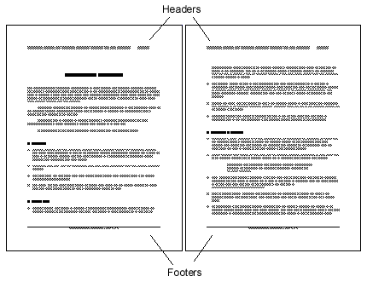
Headers and Footers
Headers are portions of a document that always appear at the top of a page, footers appear at the bottom of a page. Headers and footers display general information such as document title, chapter name, page number, author name etc.

Slide 60
Creating headers and footers
The simplest method to insert a header is :
Click above the top of the text area and when the Header marker appears, click on the + icon.
Now you can type and format the header text as any other text.
To insert a footer follow the same steps by clicking on bottom of the text area to display the Footer marker.

Slide 61
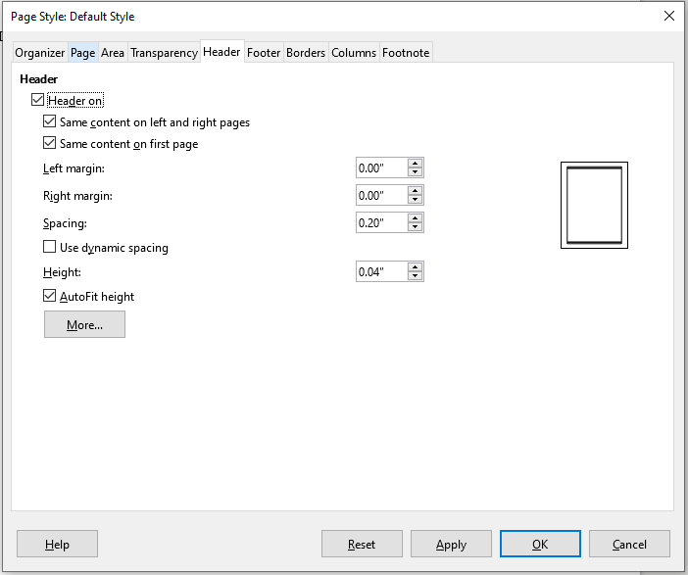
Creating headers and footers
Using the Page Style Dialog
With this method you can create headers and footer with some advanced options. Open the Page Style dialog window and enable the header and/or footer.

Slide 62

Creating headers and footers
Same content left/right
If you deselect the Same content left/right box, one can specify a different header for left or right pages.
Same content on first page
Deselecting Same content on first page allows you to set a different header for the first page of the document. For example if the first page contains a cover for a document we don't want to display the header and footer.

Slide 63
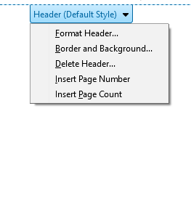
Format headers and footer
Clicking on a header marker opens a context menu with the following commands:
Format Header: Opens the Header tab in Page style window
Border and Background : Set borders and background for the header area
Delete Header: Remove the header
Insert page number : To insert page number as Header or Footer
Insert page Count : To insert Page count as Header or Footer.

Slide 64
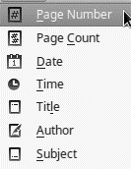
Format headers and footer
Formatting text in headers and footers
Text inside headers and footers is formatted as normal text using character and paragraph formatting commands.
Fields in headers and footers
Information such as document title, chapter titles, and page numbers, which often go into headers and footers, are best added as fields.
To insert fields, go to Insert menu-> Field

Slide 65
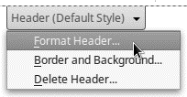
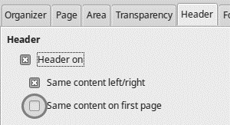
Format headers and footer
Disabling page number on the first page
Sometimes the first page of a document contains a cover and we do not want page numbering to appear on header or footer. One way to achieve this is to
Format the header of footer
Deselect the option Same content on first page.
Then you can edit the contents of the fist page header of footer to delete page numbering or all the contents.
Do not delete the header or footer, only the contents.

Slide 66
Changing Case
Changing case of selected text
To quickly change the case of text, select the text and choose Format > Text on the Menu bar and then choose one of the following:
UPPER CASE : all letters are capitalized.
lower case : no words are capitalized.
Cycle Case : cycles the selected words through upper case, lower case and capitalize every word.
Sentence case : only the first word is capitalized
Capitalize Every Word : every word is capitalized.
tOGGLE cASE : changes every letter to the opposite case.

Slide 67
Spelling and Grammar Checking

Slide 68
Spelling and grammar
In order to use this feature, the appropriate dictionaries for your language must be installed. By default, four dictionaries are installed: a spelling checker, a grammar checker, a hyphenation dictionary, and a thesaurus.
Writer provides a spelling checker, which checks to see if each word in the document is in the installed dictionary. Also provided is a grammar checker, within the Spelling dialogue, which can be enabled or disabled in the Spelling dialog.

Slide 69
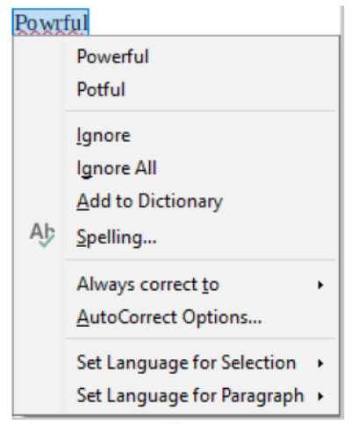
Automatic Spell Checking
Automatic Spell Checking checks each word as it is typed and displays a wavy red line under any unrecognized words.
Right-click on an unrecognized word to open a context menu. You can click on one of the suggested words to replace the underlined word with the one selected. When the word is corrected, the line disappears.

Slide 70
Automatic Spell Checking
If Automatic Spell Checking is not enabled click Tools > Automatic Spell Checking menu command to enable it.
Note: A word marked as unrecognized is not necessarily misspelled. It can simply be a name, acronym, a technical term or any other word that is not on the dictionary.

Slide 71
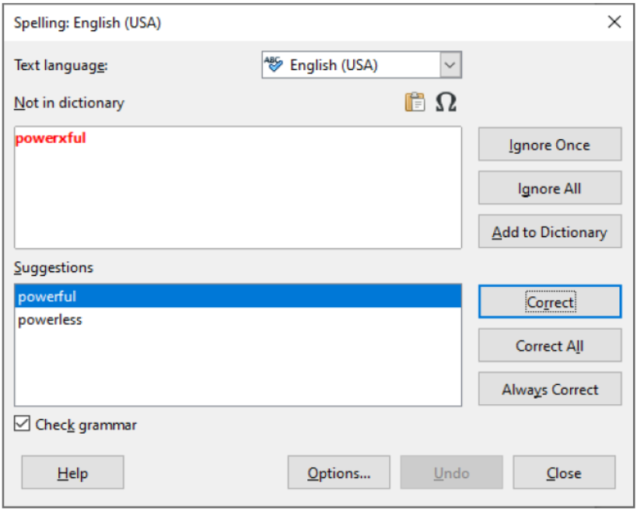
Spell checking an entire document
To perform a combined spelling and grammar check on the document (or a text selection), click the Spelling and Grammar button on the Standard toolbar, or choose Tools > Spelling and Grammar. This checks the document or selection and opens the Spelling and Grammar dialog if any unrecognized words are found. In order to use this, the appropriate dictionaries must be installed.

Slide 72
Spell checking an entire document
If an unrecognized word is found it is highlighted in red on the top pane. The bottom pane contains suggested replacement words for the highlighted word. The option to restart from the beginning of the document is offered on reaching the end of the document.
The elements of the Spelling and Grammar dialog are as follows:
Not in dictionary
The sentence containing the error is displayed in the pane. If an unrecognized word is found it is highlighted. The sentence or the word can be edited in the pane.
Suggestions
The pane contains suggested replacement words for the highlighted word. Select a word and then select Change or Change All to replace it.

Slide 73
Spell checking an entire document
Text language
The language to be used for the spell and grammar checking can be selected from this list. If the spell check is enabled for this language, a check mark is displayed in front of it.
Ignore
This one instance of the underlined word will be ignored while the document is open. Other instances, if they exist, will still be underlined. This setting is not stored with the document.
Ignore All
All instances of the word in the document will be ignored, and the word will be added to the IgnoreAllList user-defined dictionary.

Slide 74
Spell checking an entire document
Add to Dictionary
The word is added by default to the Standard dictionary.
Change
Replaces the unknown word with the suggested word. If the sentence was edited, the whole sentence is changed. For grammar, the suggested replacement is used to correct the text.
Change All
This replaces all instances of the word with the selected replacement word.
AutoCorrect
This behaves in a similar fashion to AutoCorrect described above. However, the word is not replaced and you must select one of the Change buttons.

Slide 75
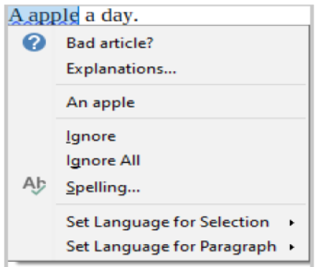
Grammar Checking
By default, Check grammar as you type is enabled in Tools > Options > Language Settings > Writing Aids > Options. Automatic Spell Checking must be enabled for this to work.
If any errors are detected, they are shown underlined by a wavy blue line. Right-clicking on this line brings up a context menu.

Slide 76
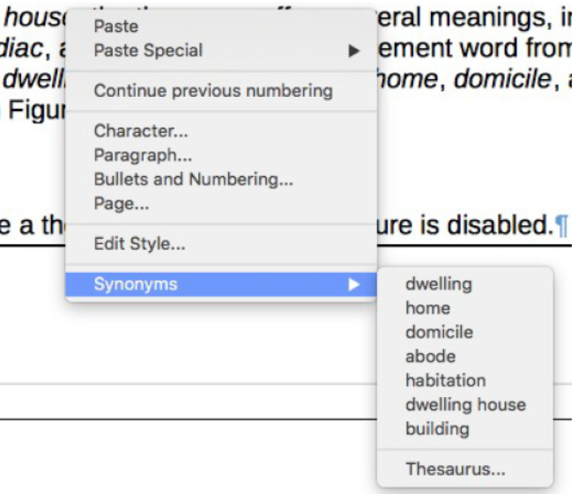
Synonyms and thesaurus
To access a short list of synonyms, right-click on a word and point to Synonyms on the context menu. A submenu of alternative words is displayed. Click on a word or phrase in the submenu to have it replace the highlighted word in the document

Slide 77
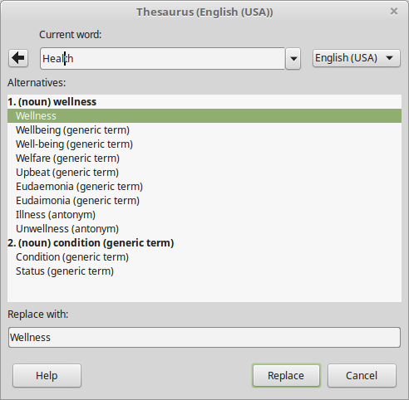
Synonyms and the thesaurus
The Thesaurus gives a more extensive list of alternative words and phrases. To use the thesaurus, click on Thesaurus from the Synonyms submenu. If the current language does not have a thesaurus installed, this feature is disabled.

Slide 78
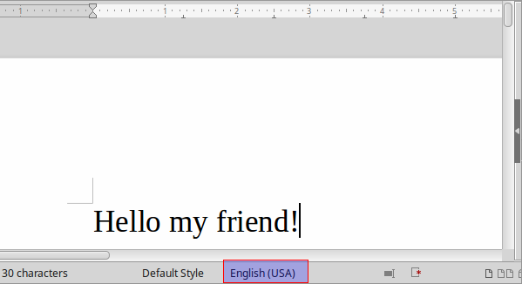
Selecting the Document Language
The language you select for your document determines the dictionary used for spell check, thesaurus and hyphenation, the decimal and thousands delimiter used and the default currency format. The default language for each document is shown in the status bar.

Slide 79
Selecting the Document Language
Change the default language for the whole document
Choose Tools > Options. Go to Language Settings > Languages.
Under Default languages for documents, select the document language for all newly created documents. If you mark For the current document only, your choice will only apply to the current document.

Slide 80
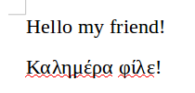
Selecting the Document Language
Assign a language to selected text, a paragraph or the whole document
If a document contains text in a language other than the default, you must manually set the text with the correct language in order to use the language tools. In the example below the Greek is unrecognized by the spell checker because the document language is set to English.

Slide 81
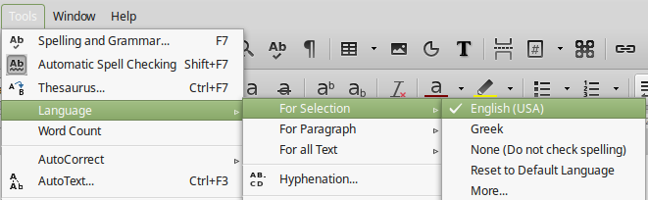
Selecting the Document Language
However you can you can assign a language to selected text, a paragraph or all the text in a document. Select the text and choose Language > For Selection from the main menu and assign the correct language. Similarly you can assign a language to a paragraph or all the text.

Slide 82
Using AutoCorrect
Writer’s AutoCorrect function includes a long list of common misspellings and typing errors, which it corrects automatically.
AutoCorrect is turned on when Writer is installed. You may wish to disable some of its features, modify others, or turn it off completely.
You can add your own corrections or special characters or change those supplied with LibreOffice.
Select Tools > AutoCorrect > AutoCorrect Options to open the AutoCorrect dialog. On the Replace tab, you can define what strings of text are corrected and how.

Slide 83
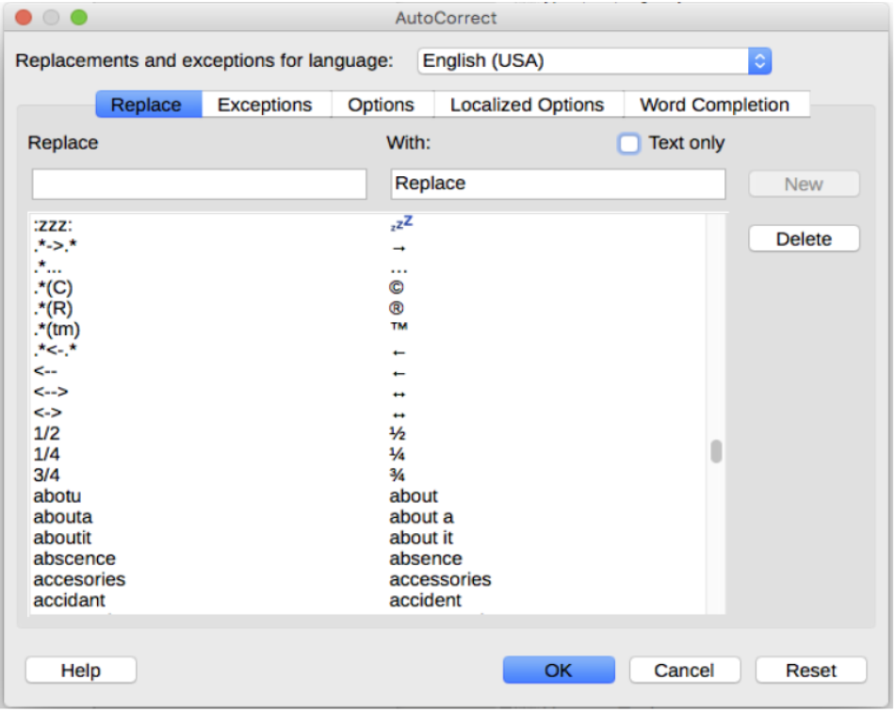
Using AutoCorrect

Slide 84
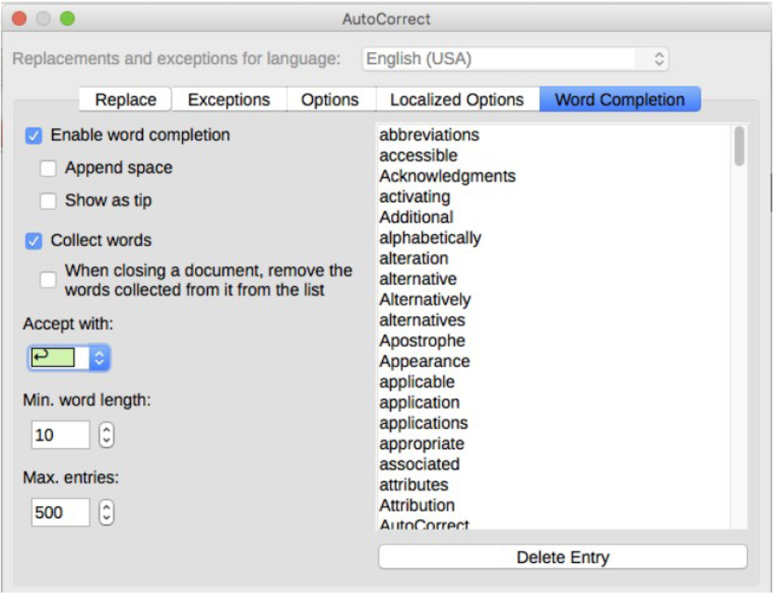
Word completion
If Word Completion is enabled, Writer tries to guess which word you are typing and offers to complete the word for you. To accept the suggestion, press Enter. Otherwise, continue typing.
To turn off Word Completion, select Tools > AutoCorrect > AutoCorrect Options > Word Completion and deselect Enable word completion.

Slide 85
Hyperlinks

Slide 86
Hyperlinks
A hyperlink is a text or graphic in a document that links to a resource such as webpage address or a file. The World Wide Web is comprised of hyperlinks linking trillions of pages and files to one another.
When you type text (such as website addresses or URL) that can be used as a hyperlink, and then press the spacebar or the Enter key, Writer automatically creates the hyperlink and applies formatting to the text.

Slide 87
Creating hyperlinks
To manually create a hyperlink select the text and then click on the hyperlink icon to display the Hyperlink dialog window
You can also use the keyboard shortcut Ctrl+K.

Slide 88
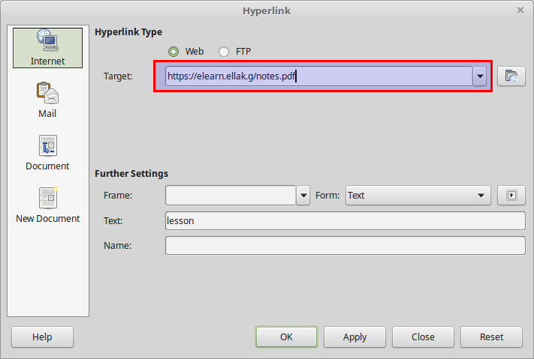
Creating hyperlinks
Select one of the four types of hyperlink:
Internet: a web address, normally starting with http://
Mail: an email address.
Document: another document or to another place in the presentation.
New document: the hyperlink creates a new document.

Slide 89
Creating hyperlinks
The top right part of the dialog changes according to your choice for the hyperlink type.
For an Internet hyperlink, choose the type of hyperlink (Web or FTP) and enter the required web address (URL).
For a Mail hyperlink, specify the receiver address and the subject.
For a Document hyperlink, specify the document path, leave this blank if you want to link to a target in the same document. Specify the target in the document. Click the Target icon to open the Navigator where you can select the target, or if you know the name of the target, you can type it into the box.
For a New Document hyperlink, specify whether to edit the newly created document immediately or just create it and the type of document to create (text, spreadsheet, and so on).

Slide 90

Edit or Delete a hyperlink
To edit or delete a hyperlink, right click on the text that contains the link and choose edit or delete.

Slide 91

Hyperlinks to images
Hyperlinks to images can also be created just like text and other Writer objects. The procedure is the same, select the image, click the hyperlink button and type the link.
Remove a hyperlink from an image
If you right click on an image with a hyperlink there is no option of removing it. Instead double click on the image to display the Image Format window, select the Hyperlink tab and delete the url.
Activate a hyperlink
To activate a hyperlink inside a document hold down the CTRL key and then click inside the link.

Slide 92
Footnotes and Endnotes

Slide 93
Footnotes and Endnotes
Footnotes and Endnotes are basically references to additional information found on the bottom of the document. Footnotes appear at the bottom of the page on which they are referenced. Endnotes are collected at the end of a document.
If you have a very long piece of text to enter, it might be more appropriate to add this as an endnote. Similarly with references, where the reader is more likely to need this information after they have read your paper, these should be added as endnotes.

Slide 94

Footnotes and Endnotes
The text shown in the image below has two references, numbered 1 and 2, with footnotes displayed at the bottom of the page.

Slide 95

Inserting footnotes or endnotes
To insert a footnote or endnote:
Place the cursor where you want the footnote or endnote marker to appear.
Then select Insert > Footnote and Endnote from the Menu bar and choose Footnote or Endnote, or click the Insert Footnote or Insert Endnote button on the Standard toolbar.
The cursor will be moved to the footnote or endnote area, prompting you to type the text.
Now the reference will appear on your text with an number. You can also use the number as a link to the footnote or endnote

